Slide 1


FS Engineering Metrics
February 2020
MBR Report
Notes:
Introduction

Slide 2

Contents
Workstream Progress
Story Point Planning Analysis
JIRA Burndown Charts.
Test Execution Metrics (automated).
Defect Trends
Monthly JIRA Dashboards per Release.
YTD JIRA Dashboards + Production Defects.
EIM/APPS Automation Trends.
Release QA Metrics. (Appendix)

Slide 3
Workstream Programs – Progress

Slide 4
FS Engineering Scrum Teams – February 2020
FS Engineering Teams
The following slides show the range of development across multiple locations within FS Engineering;
Regulatory Compliance
Archeo – APPS development
Flash – APPS development
WLM APPS – APPS development
WLM Platform – EIM Platform development
P+C (Insurance Fraud)
Atlantis – SNA Platform development (formerly team Pegasus)
Maya – SNA Platform development
Simba – SNA Platform development
Cleopatra – SNA Platform development
Portfolio
Setanta – EIM Platform development
Rubiks – EIM Platform development
Ducks – Scenario Manager UI development
AAP – Advanced Analytics development
Development Support
Devbobs – SNA Platform development (DevOps)
Achilles – SNA development support
Banking Fraud
Frogs – APPS development

Slide 5
2019/20 Financial Services Technical Roadmap
Key
- Concept
- Pre-concept
- Plan Commit
2019 – Q3
2019 – Q4
2020 – Q1
2020 – Q2
2020 – Q3
2020 – Q4
Version 8.1
Version 8.2
Advanced Analytics Platform 2.5
Model Gov. visualisation, EIM SSO, big data & Oracle support
AAP 2.6
Model Gov. report, data drill down, and model simulation
AAP 8.1.0
Alert explanation and improve deployment flexibility (PMML)
AAP 8.1.1
Track model performance, and simulation of Fraud models
AAP 8.1.2
Data partitioning, simulation learning
Hosted Solution SaaS deployment capability for FinCrime solution
Advanced
Advanced
Advanced
Advanced
PORTFOLIO
Data Management Dynamic Schemas PoC improving data storage
Dynamic NetReveal (Q1 2022) Simplify upgrades, increase personalisation, support cloud adoption reducing TCO, and reduce engineering overhead
Technical Modernisation
3rd party cert, security updates, supported platforms
Technical Modernisation
Security, 3rd party library upgrades
Enhanced
Mixed
Open Source Database
Low cost database deployment for Reg Disclosures (SAR) & AML Opt
Functional Enhancements
Alert prioritisation, AML risk, Packaging of SMBD for AML
CDD Enhancements
Exposure of CDD Risk Scores
Enhancements
Alert intel visuals, alert prioritisation for WLM & CDD
Hosted Solution (US)
Public hosted version for Compliance to focus on Tier 2 customers
Mixed
Advanced
Hosted Solution (UK)
Public hosted version for Compliance to focus on Tier 2 customers
Advanced
AML Contributions
Improve risk scoring through feeding AML behaviour into CDD risk score
SNA for Compliance
Improve detection with entity resolution and network building
Foundation
REGULATORY COMPLIANCE
CDD Onboarding & ODD Integration of RTDE with CDD/KYC to provide real time on-boarding
WLM Enhancements
24/7 alert gen / micro nodes
Advanced
Mixed
PF Enhancements
Improvements to scenarios, PF dashboard, and DPA integration
Real-time Channel
New ISO20022 adaptor, US real time payments, 3rd party data ingestion
Foundation
Enhanced
BANKING
FRAUD
Omni-Channel
Omni-channel detection integrating new risk signals
AAM Modernisation (MVP) Next generation of AAM solution including real time risk scoring
Foundation
Property & Casualty 3.2
Canatics: elastic search, smart spidering, dossier saving, and Java 11
Hosted Solution (UK)
Public hosted version for Insurance Fraud customers
Property & Casualty 3.3
Real time scoring, Guidewire integration, PMML
Property & Casualty 3.4
US Regionalisation, 3rd party integration, financial tracking
INSURANCE
FRAUD
Project Support
Supporting in flight projects
Hosted Solution (US)
Public hosted version for Insurance Fraud customers

Slide 6
Scrum Team Metrics – February 2020
APPDEV Metrics for APPS V8.1 Development Teams – 1 – Archeo Team SPs + Velocity
Sprint 31 : Sprint Goal was achieved. ”Complete work related to CTR Involved Persons Changes and Multiple Transactions Flag.”
Sprint 32 : Sprint Goal was achieved. “Complete all tasks related to APPS 8.1 and DPA.”
Sprint 33 : Sprint Goal was achieved. Support NR 8.1 Release.

Slide 7
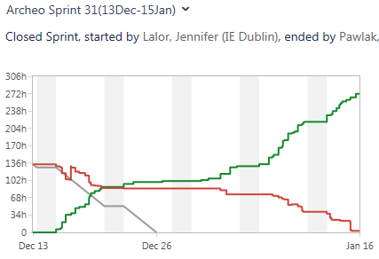
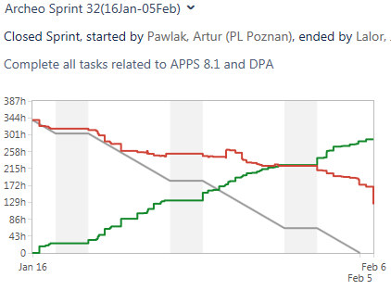
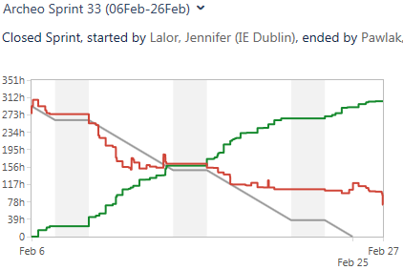
Scrum Team Metrics – February 2020
Metrics for APPS V8.1 Development Teams – 2 – Archeo Team Burndown Charts
Sprint 31 : 28 SPs forecast / 24 SPs achieved. All priority CTR related User Stories were completed. The AML Opt User Story not completed was carried over to Sprint 32. Team Happiness Index – 8.4.
Sprint 32 : 48 SPs forecast / 15 SPs achieved. The majority of the User Stories related to the Sprint Goal were completed. User Stories related to performance did not finish in this Sprint cycle and will be picked up in a later Sprint. Team Happiness Index – 8.4.
Sprint 33 : 64 SPs forecast / 46 SPs achieved. A number of defects closed in preparation for NR 8.1 release. AML Opt Data Source User Story completed. Team Happiness Index – 8.5.

Slide 8
Scrum Team Metrics – February 2020
APPDEV Metrics for APPS V8.1 Development Teams – 1 – Flash Team SPs + Velocity
Sprint 39 : Sprint Goal was not achieved :- “Validate OB and ODD on Postgres, implement adjust risk functionality”.
Sprint 40 : Sprint Goal was achieved :- “Get CDD Functionally complete and stable for 8.1 release.”
Sprint 41 : Sprint Goal was achieved :- “Contribute to successful Release 8.1”.

Slide 9
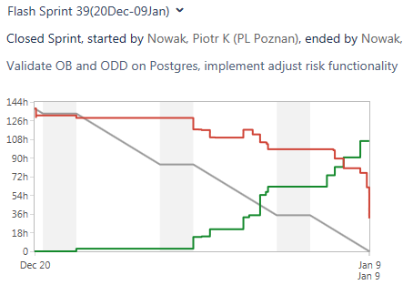
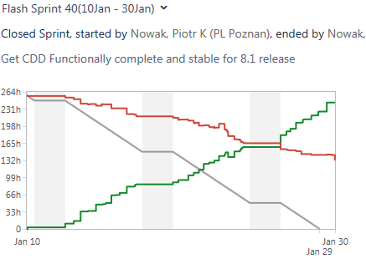
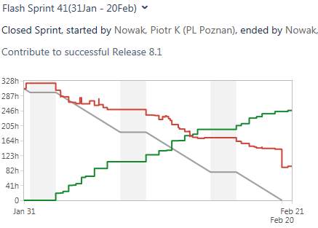
Scrum Team Metrics – February 2020
APPDEV Metrics for APPS V8.1 Development Teams – 2 – Flash Team Burndown Charts
Sprint 39 : 18 SPs forecast / 15 SPs achieved. The team felt that they had performed well and partially achieved the forecasted goal of the Sprint. User Story on CDD External Risk Factors (APPSDEV-4972) was not completed in this Sprint.
Sprint 40 : 41 SPs forecast / 20 SPs achieved. Despite a number of User Stories remaining incomplete at Sprint end, the team felt that they had completed the most important work items, and addressed a number of defects that lead to quality improvements.
Sprint 41 : 43 SPs forecast / 22 SPs achieved. The focus for the team was to complete tasks relating to release activities for NR 8.1.

Slide 10
Scrum Team Metrics – February 2020
Regulatory Compliance Metrics for APPS V8.1 - WLM APPS Team SPs + Velocity
Sprint 59 : Sprint Goal achieved. Forecasted CDD Messaging User Story and a number of defect resolutions delivered.
Sprint 60 : Sprint Goal achieved. The Sprint included a number of 8.1 Release preparation tasks and a PoC on Scenario Manager Alert Triage.
Sprint 61 : Sprint Goal achieved. The Sprint included Festival and Regression test tasks, and follow up resolutions, as part of the NR 8.1 Release.

Slide 11
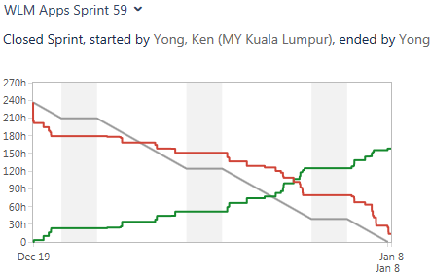
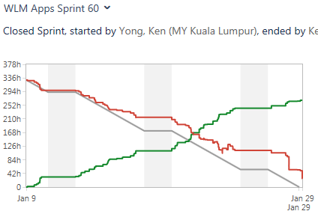
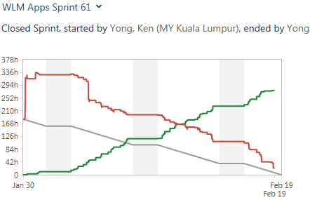
Scrum Team Metrics – February 2020
Regulatory Compliance V8.1 - WLM APPS Team Burndown Charts
Sprint 59 : 29 SPs forecast / 25 SPs achieved. All priority tasks for Sprint goal achieved.
Sprint 60 : 36 SPs forecast / 32 SPs achieved. A small number of documentation tasks have been carried over to the next Sprint.
Sprint 61 : 35 SPs forecast / 26 SPs achieved. ‘Vanilla’ upgrade and build verification tasks pushed to a later Sprint.

Slide 12
Scrum Team Metrics – February 2020
Regulatory Compliance Metrics for EIM V8.1 – WLM Platform Team SPs + Velocity
Sprint 59 : Sprint Goal achieved. Priority regression defect and defect resolution completed.
Sprint 60 : Sprint Goal achieved. Key preparation tasks completed, as part of 8.1 Release preparation.
Sprint 61 : Sprint Goal achieved. Benchmarking and SWIFT MX test automation completed during Sprint.

Slide 13
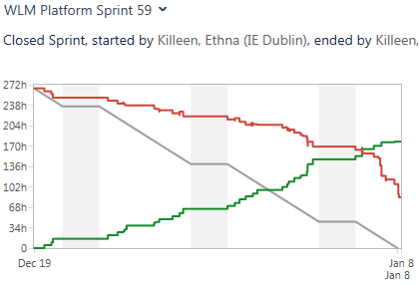
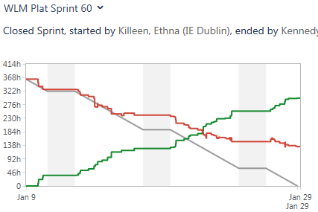
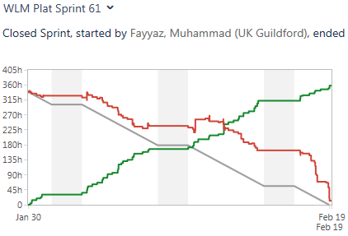
Scrum Team Metrics – February 2020
Regulatory Compliance Metrics for EIM V8.1 – WLM Platform Team Burndown Charts
Sprint 59 : 23 SPs forecast / 14 SPs achieved. Lack of documentation on XDiff User Story made it difficult to complete in this Sprint (carried forward and finished in Sprint 60). JBoss/Postgres benchmarking remains in progress.
Sprint 60 : 30 SPs forecast / 23 SPs achieved. Forecasted test automation/regression and defect resolution tasks completed. JBoss/Postgres benchmarking finished. WAS/ORACLE 8.1 benchmarking in progress.
Sprint 61 : 27 SPs forecast / 28 SPs achieved. All forecasted work completed in Sprint cycle, along with an additional 1 SP bug fix.

Slide 14
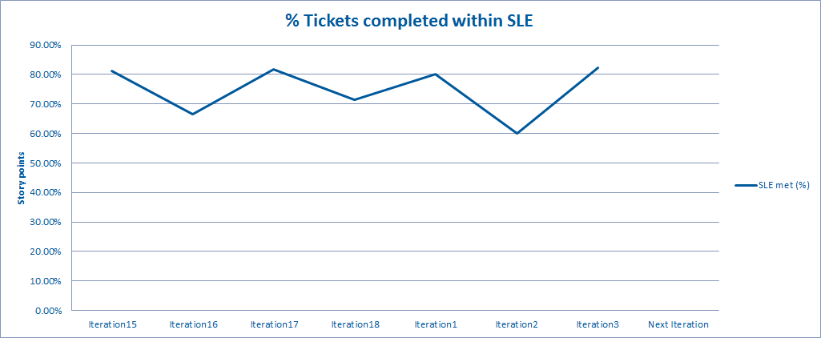
Kanban Team Metrics – February 2020
SNA Metrics for Development Teams – 1 – Team Devbobs
Team Service Level Expectation: 70% of PBIs will be completed within 5.5 days
(This is an SNA Kanban team. Devbobs are the Continuity team members who were keen to continue with Dev ops).
Iteration 1 (2020) : 80% of Sprint Backlog items in 5.5 days.
Iteration 2 (2020) : 60% of Sprint Backlog items in 5.5 days.
Iteration 3 (2020) : 82% of Sprint Backlog items in 5.5 days.
Retrospective Themes
Positive (‘smiley face’) rating from the team members on Iterations 1, and 3 (2020) outcomes.
Iteration 2 was a neutral rating from team due to demo coordination challenges and problems with User Stories not being split into more manageable divisions.
Good progress on bug fixing and technical debt reduction in latest Iteration (infrastructure challenges less of an issue).
Devbobs is a smaller team than Continuity (4 : 3 – KL, 1 - UK), and this has made it easier to track work.

Slide 15
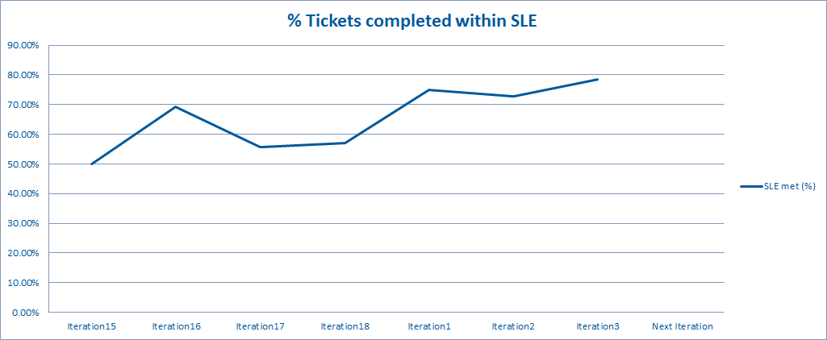
Kanban Team Metrics – February 2020
SNA Metrics for Development Teams – 1 – Team Simba
Team Service Level Expectation: 70% of PBIs will be completed within 5.5 days
(This is an SNA Kanban team. Simba are the Continuity team members who were keen to take on more feature team work; split out into a new team, they have 6 team members, all in KL).
Iteration 1 (2020) : 75% of Sprint Backlog items in 5.5 days.
Iteration 2 (2020) : 73% of Sprint Backlog items in 5.5 days.
Iteration 3 (2020) : 79% of Sprint Backlog items in 5.5 days.
Retrospective Themes
5/6 positive rating from the team members on Iteration 2. ‘All Smiles’ for Iteration 3 (2020).
The team is almost in the last stage of finalizing the elements to be moved to SNA Config as part of that Epic.
Backlog Refinements and SLE targets are consistently improving.
Simba is a smaller team than Continuity, and this has made it easier to track work.

Slide 16
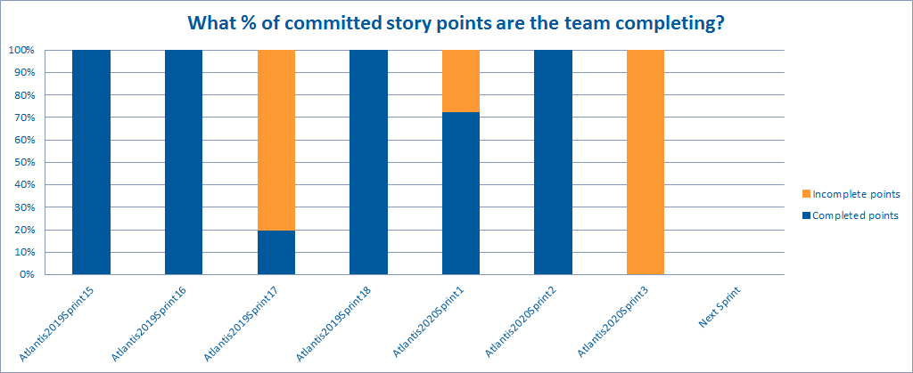
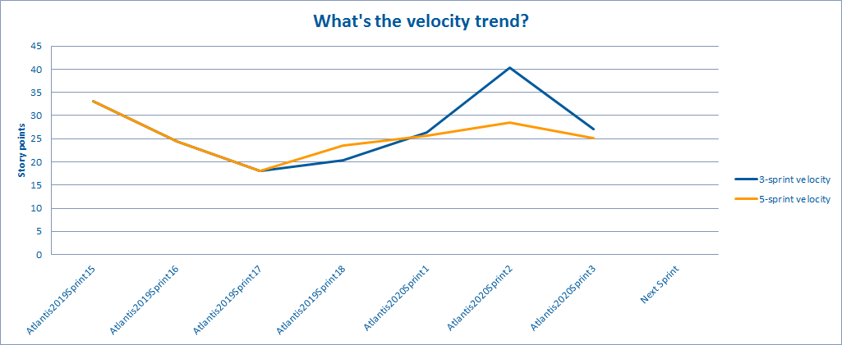
Scrum Team Metrics – February 2020
SNA Metrics for Development Teams – 1 – Team Atlantis SPs + Velocity
(This is an SNA Scrum team, but is the renamed and slightly amended former Pegasus team. Iteration numbers are shared across all SNA teams).
Sprint 1 (2020) : Good progress being made on User Stories within the ‘In-Flight’ initiative. However, not all forecasted work was completed.
Sprint 2 (2020) : All forecasted User Stories completed, including ‘In-Flight’ items from Sprint 1.
Sprint 3 (2020) : Sprint contained one large Search export User Story (SNA-23375), which was not fully completed.

Slide 17
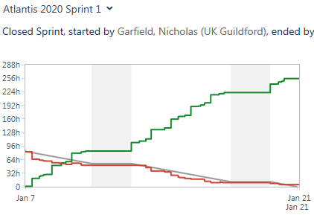
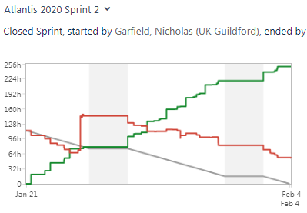
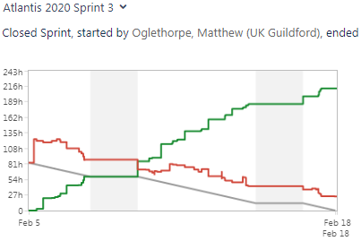
Scrum Team Metrics – February 2020
SNA Metrics for Development Teams – 2 – Team Atlantis Burndown Charts
Sprint 1 (2020) : 47 SPs forecast, 34 SPs delivered (Confluence Metrics). Retrospective theme : - ‘flat’. The 13 SP User Story SNA-25439 (Allow stats component to be run at the end of a sub-pipeline) was not completed as forecast in the Sprint.
Sprint 2 (2020) : 47 SPs forecast, 47 SPs delivered (Confluence Metrics). Retrospective theme : - ‘happy’. The team coordinated well to close out all forecasted User Stories.
Sprint 3 (2020) : 20 SPs forecast, 0 SPs delivered (Confluence Metrics). Retrospective theme : - ‘happy’. The User Story carried over from Sprint 2, SNA-22375 : Allow full Search export to be run, was not fully completed. However, the team felt that the had coordinated very well on the User Story and resolved some technical debt tasks in parallel to improve Builder integration. (Those tasks were not assigned Story Points in the Sprint backlog).

Slide 18
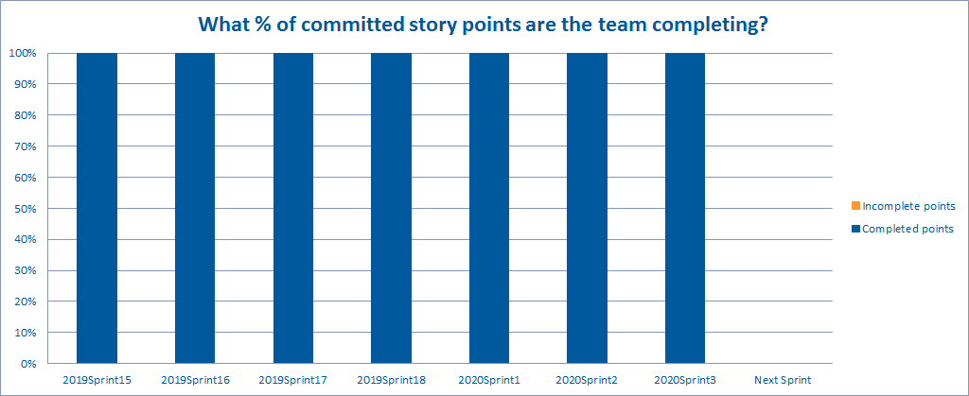
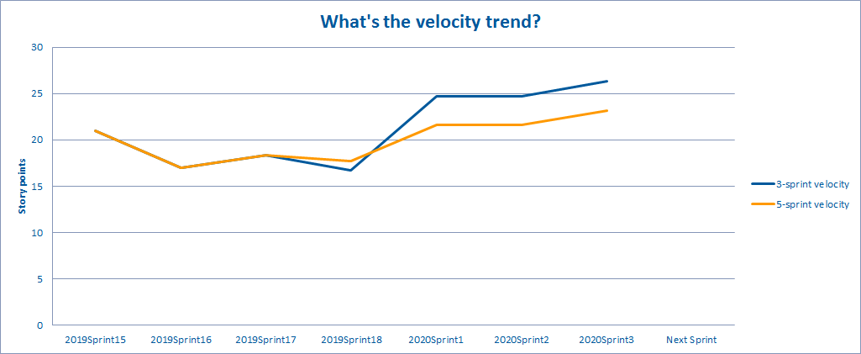
Scrum Team Metrics – February 2020
SNA Metrics for Development Teams – 1 – Team Maya SPs + Velocity
Sprint 1 (2020) : All forecasted commitments completed, including tasks on delivering ‘in-flight’ metrics and applications.
Sprint 2 (2020) : All forecasted commitments completed, including three ‘Spike’ tasks to fix issues with the recent Spring 5 upgrade.
Sprint 3 (2020) : All forecasted commitments completed, including enhancements to ‘in-flight’ webapp, and Excel export option in Visualizer.

Slide 19
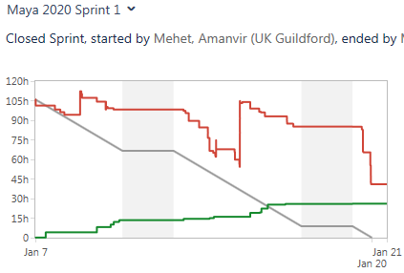
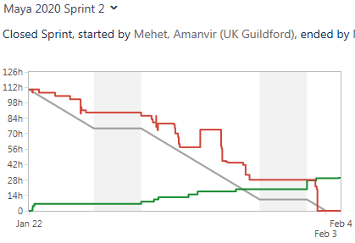
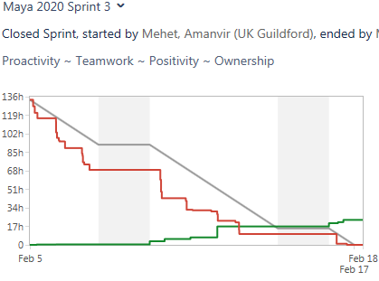
Scrum Team Metrics – February 2020
SNA Metrics for Development Teams – 2 – Team Maya Burndown Charts
Sprint 1 (2020) : 37 SPs forecast, 37 SPs completed (Confluence Metric). Retrospective theme : All 6 – ‘happy’. Team working well collaboratively but planning future actions to further improve the code review process.
Sprint 2 (2020) : 21 SPs forecast, 21 SPs completed (Confluence Metric). Retrospective theme : All 6 – ‘happy’. Improvements to code review process and collaboration with Atlantis team helped to plan and execute Sprint cycle successfully.
Sprint 3 (2020) : 21 SPs forecast, 21 SPs completed (Confluence Metric). Retrospective theme : All 6 – ‘happy’. The team is continuing to effectively carry over process improvements from previous Sprints and conclude forecasted work in Sprint cycle.

Slide 20
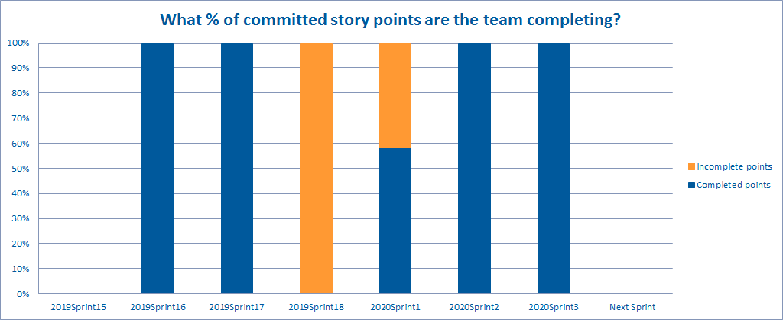
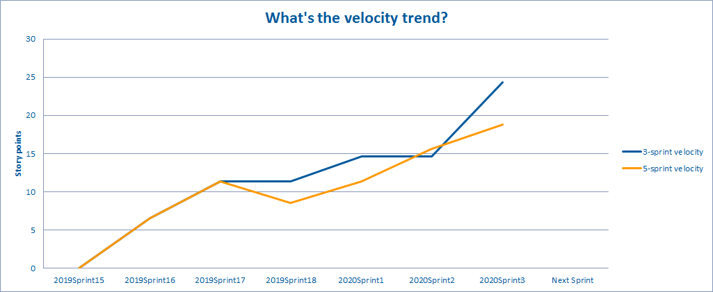
Scrum Team Metrics – February 2020
SNA Metrics for Development Teams – 1 – Team Cleopatra SPs + Velocity
(This is an SNA team, which is a Guildford-based Scrum feature team. Iteration numbers are shared across all SNA teams).
Sprint 1 (2020) : Larger User Story on build pack information completed, and one 13 SP User Story on ‘config layers’ incomplete.
Sprint 2 (2020) : Some User Stories on EIM outcome data were rejected in the Sprint cycle but were replaced with an Outcome View change and a Spring 5 upgrade ‘spike’ task.
Sprint 3 (2020) : All forecasted commitments completed, along with additional Spring 5 and Java 11 upgrade tasks.

Slide 21
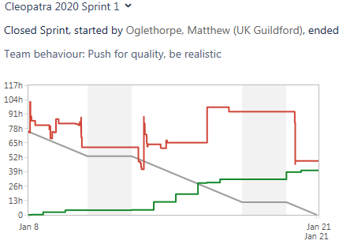
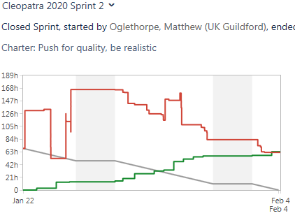
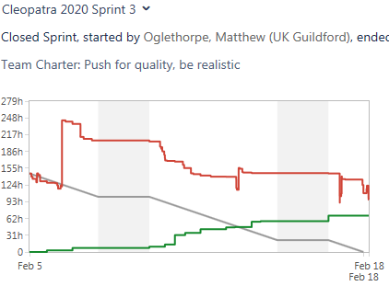
Scrum Team Metrics – February 2020
SNA Metrics for Development Teams – 2 – Team Cleopatra Burndown Charts
Sprint 1 (2020) : 31 SPs forecast, 23 SPs completed (JIRA Metric). Retrospective theme : ‘happy’ (4/7 score). The team did not complete one 13SP story: SNA-24331 Load config from layers. The Sprint length (two weeks) can be a challenge for the team to complete larger User Stories.
Sprint 2 (2020) : 21 SPs forecast, 21 SPs completed (JIRA Metric). Retrospective theme : ‘happy’ (3/5 score). Not all originally forecast work was completed, but it was possible to include additional tasks mid-Sprint cycle.
Sprint 3 (2020) : 21 SPs forecast, 29 SPs completed (JIRA Metric). Retrospective theme : ‘happy’ (5/6 score). SNA Config and technical debt tasks proceeded well in parallel with other items in the Sprint backlog.

Slide 22
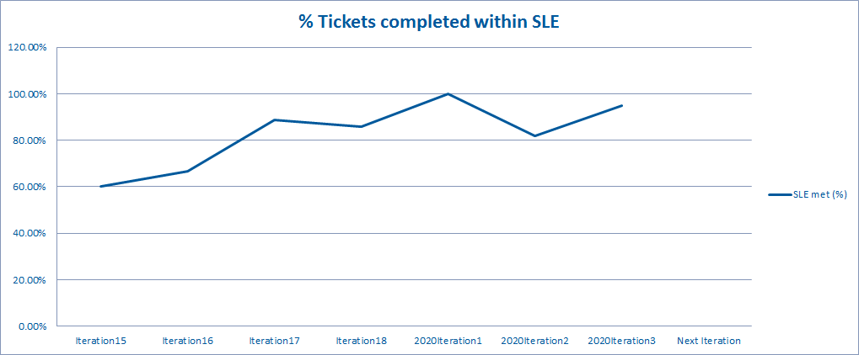
Kanban Team Metrics – February 2020
SNA Metrics for Development Teams – 1 – Team Achilles
Team Service Level Expectation: 70% of PBIs will be completed within 5.5 days
Iteration 1 (2020) : 100% of Sprint Backlog items in 5.5 days.
Iteration 2 (2020) : 82% of Sprint Backlog items in 5.5 days.
Iteration 3 (2020) : 95% of Sprint Backlog items in 5.5 days.
Retrospective Themes
3/3 positive ratings from team members on Iteration 1 (2020). Teamwork strong, ticket planning good, 100% SLE achieved.
The team was split on its rating for Iteration 2 – 2 ‘smiles’ and 2 ‘grims’. Some team members felt items in Sprint backlog would have benefitting from additional refinement and re-planning.
Iteration 3 was rated 3.5/4. Early merging and reviews of Sprint backlog items proved effective.

Slide 23
Scrum Team Metrics – February 2020
EIM Platform V8.1 Metrics for Development Teams – 1 – Team Setanta – SPs + Velocity
Sprint 97 : Sprint Goal achieved. The key HighCharts implementation objectives were achieved. REACT training impacted on Sprint velocity more than expected.
Sprint 98 : Sprint Goal achieved. The team completed regression testing in advance of the NR 8.1 Release, along with priority defect resolutions and Tomcat 8.0.1 certification.
Sprint 99 : Sprint Goal achieved. 8.1 Platform components all completed, along with priority defect fixes.

Slide 24
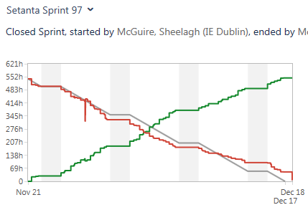
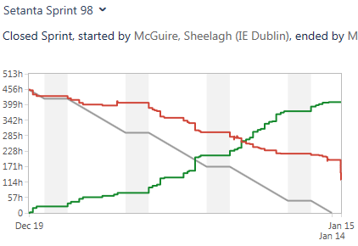
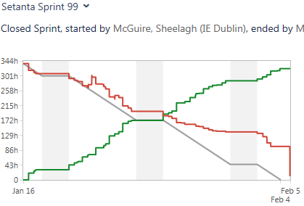
Scrum Team Metrics – February 2020
EIM Platform Metrics for V8.1 Development Teams – 2 – Team Setanta Burndown Charts
Sprint 97 : 35 SPs forecast / 27 SPs achieved. Not all HighChart functional elements were completed, and some minor test automation tasks were also dropped because of environmental challenges. However, the team felt that they had collaborated well to deliver key Sprint goals. Team Health – 8.0 : Sprint score from the team.
Sprint 98 : 26 SPs forecast / 19 SPs achieved. The team prioritised QA regression and defect fix verification over QA automation stories and lower category defects, which meant some User Stories were carried over. The QA regression time needed to support the extra stacks, such as PostGres/Tomcat and PostGres/Liberty, was underestimated. Team Health – 7.5 : Sprint score from the team.
Sprint 99 : 12 SPs forecast / 13 SPs achieved. This Sprint cycle involved a smaller volume of Story Points because Dynamic NetReveal training was planned for the team during the immediate post NR 8.1 timeframe. Team Health – 8.0 : Sprint score from the team.

Slide 25
Scrum Team Metrics – February 2020
EIM Platform V8.1 Metrics for Development Teams – 1 – Team Rubiks – SPs + Velocity
Sprint 98 : Sprint goal achieved. Regression tasks completed in advance of 8.1 Release.
Sprint 99 : Sprint goal achieved. Tomcat testing and defect fixing completed on Oracle/Postgres.
Sprint 100 : Sprint goal achieved. Acunetix penetration test completed and DOS vulnerability defect resolved. A number of additional smaller tasks were also completed and demoed.

Slide 26
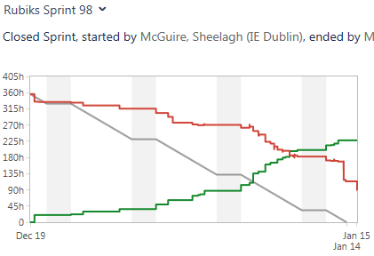
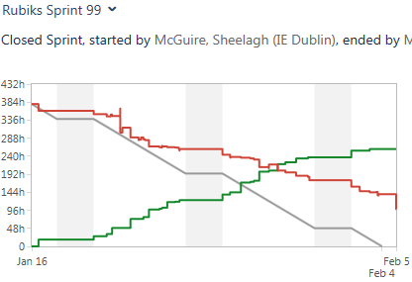
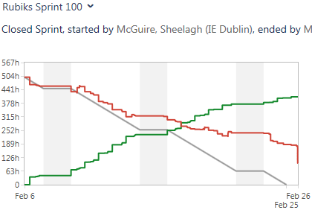
Scrum Team Metrics – February 2020
EIM Platform Metrics for V8.1 Development Teams – 2 – Team Rubiks Burndown Charts
Sprint 98 : 29 SPs forecast / 23 SPs achieved. Kerberos authentication User Story is larger/more complex than anticipated, as more config needed for App servers than expected. Team Health – 6.0 : Sprint score from the team.
Sprint 99 : 21 SPs forecast / 16 SPs achieved. Environment set up and analysis of Kerberos authentication testing is taking longer than anticipated. Team Health – 7.0 : Sprint score from the team.
Sprint 100 : 28 SPs forecast / 20 SPs achieved. Kerberos authentication task remains in progress, partly due to environmental challenges. Team Health – 6.0 : Sprint score from the team.

Slide 27
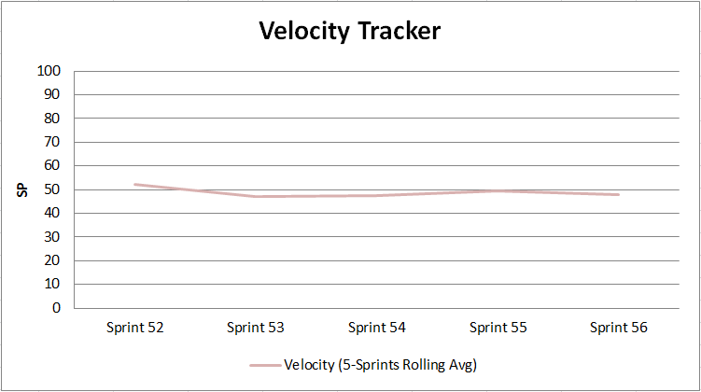
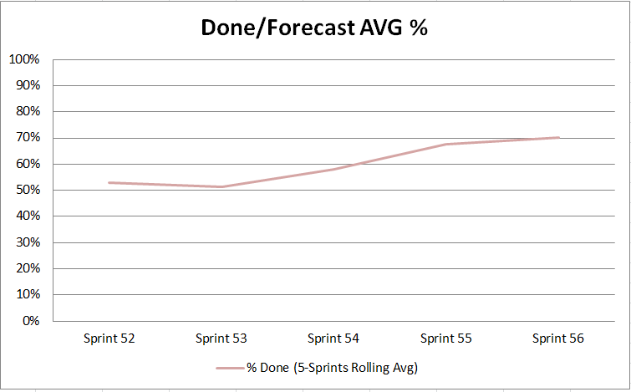
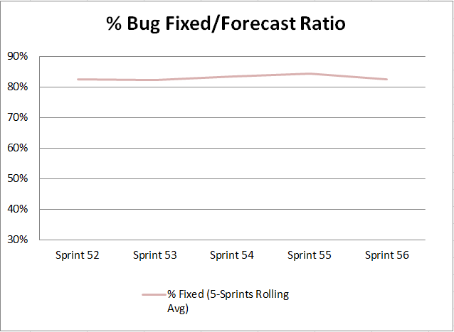
AGILE Team Metrics – February 2020
AAP Metrics for AAP 8.1.x Development Teams – Advanced Analytics Team
Retrospective Themes
Sprint 54 – 2019 Q4 (v8.1) Release delivered. Number of outstanding bugs significantly reduced.
Sprint 55 – January 2020 - Sprint Goal met :- “Decision boundary optimization”. Sprint well planned and all priority tasks completed.
Sprint 56 – February 2020 - Sprint Goal met :- Significant progress made on delivery of User Stories within “Class Imbalance Solutions” Epic. Expanded application with useful features (oversampling in task form, modernized server upload).

Slide 28
Scrum Team Metrics – February 2020
SM UI Metrics for APPS V8.1 Development Team – ‘Ducks’ - SPs + Velocity
This is a team established to deliver the new interface for Scenario Manager.
Sprint 18 : Sprint Goal not achieved :- “Compare Configurations; Close out SMUI Decoupling.”
Sprint 19 : Sprint Goal achieved :- “Compare Configurations; Complete out SMUI Decoupling; Adjust use of Virtual Fields in Setter Profiles.”
Sprint 20 : Sprint Goal not achieved :- “Enhance Compare Configurations; complete setter profiles.”

Slide 29
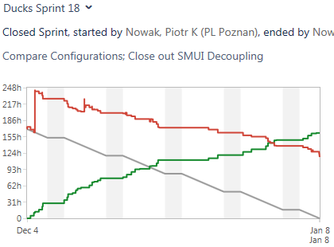
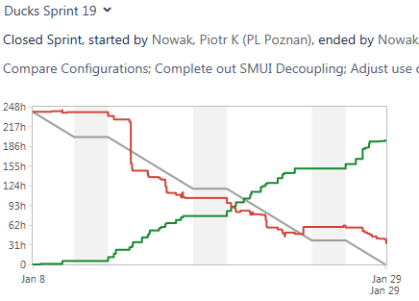
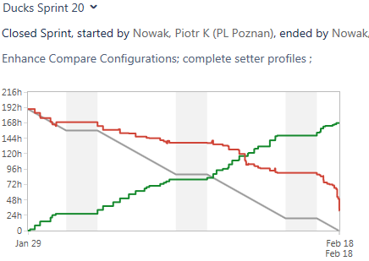
Scrum Team Metrics – February 2020
SM UI Metrics for APPS V8.1 Development Team – ‘Ducks’ - SPs + Velocity
Sprint 18 : 31 SPs forecast / 16 SPs achieved. The team was involved in a number of important client support work items. Compare Configurations User Story (FCENG-11013) was carried over to Sprint 19, and has since been completed.
Sprint 19 : 36 SPs forecast / 25 SPs achieved. Key Sprint goal achieved with the exception of Setter Profile User Story (FCENG-12111) being carried over to Sprint 20. Priority 8.1 tasks around regression also completed.
Sprint 20 : 32 SPs forecast / 23 SPs achieved. Coordination with ongoing Dynamic NetReveal training/development impacted on forecasted objectives for this Sprint. Setter Profile work carried over to following Sprint.

Slide 30
Scrum Team Metrics – February 2020
Payment Fraud Metrics for APPS V8.1 Development Team – ‘Frogs’ - SPs + Velocity
This is a new team established to deliver the next phase of Product development for Payment Fraud functionality.
Sprint 16 : Sprint Goal not achieved :- “Wire Payments adaptation.”
Sprint 17 : Sprint Goal achieved :- “Wire Adaptation and Persistence”.
Sprint 18 : Sprint Goal achieved :- “Support Fraud 8.1 Release”.

Slide 31
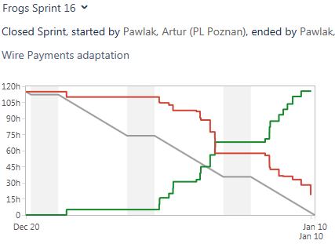
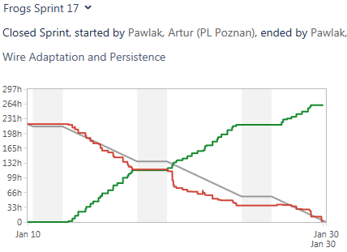
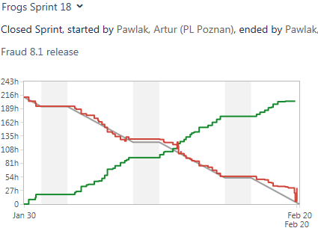
Scrum Team Metrics – February 2020
Payment Fraud Metrics for APPS V8.1 Development Team – ‘Frogs’ - SPs + Velocity
Sprint 16 : 51 SPs forecast / 10 SPs achieved. Gaps in team knowledge around WIRE payments resulted in insufficient time remaining in the Sprint to completed testing on those major User Stories. Team Happiness Index – 8.0 : Sprint score from the team.
Sprint 17 : 75 SPs forecast / 65 SPs achieved. The team coordinated well to ensure major WIRE Payment User Stories were all completed as forecast. Team Happiness Index – 7.6 : Sprint score from the team.
Sprint 18 : 42 SPs forecast / 50 SPs achieved. Task FCENG-13195 – Load Scenario Manager model from the DB – not completed in Sprint but additional work was added and completed mid-cycle. Team Happiness Index – 7.8 : Sprint score from the team.

Slide 32
Story Points – Planned v Actual Graphs (Global)

Slide 33
Completing Planned Story Points – February 2020
Review in the last three Sprints as to how many planned SPs are being delivered
This data is an average across 15 FS Engineering AGILE teams, based on their last three completed Sprints.
The ‘Global’ numbers have been adjusted to smooth out some of the effects one or two challenging Sprint(s) can have on the overall average.
In general, teams are completing 80% on their forecasted Sprint tasks on a consistent basis. (This is an abstracted metric across a large variety of work).
The lead in to the NR 8.1 release in February appears to have generated a greater degree of planning inaccuracy for the EIM Scrum teams.

Slide 34
EIM / SNA QA and Defect Metrics

Slide 35
1 – EIM/SNA QA – Automation Metrics

Slide 36
FS Engineering QA Test Metrics – February 2019
FS Engineering QA metrics reported for test automation execution
QA activity in each Scrum team creates and executes test cases in each Sprint for every new feature developed for a release, which are combined with existing regression and executed through regular test automation runs (weekly, bi-weekly, etc..).
The following slides are current reports on test execution across;
SMBD/ARTE
SMBD and ARTE test coverage of functionality is effectively 100% and tests are run on a weekly basis (Sprints run on a 2-week cycle – hence reports reflect these intervals).
EIM Base Platform / Application Builder.
V8.1 EIM BP/AB automated test cases are run at least weekly. The metrics on this slide present the key test execution cycles during V8.1 Sprint activity.
WLM
WLM Platform and APPS Scrum teams automate tests for all new functional changes in WLM 8.1. These tests are run in sequence throughout the Sprint cycles as the functionality is delivered to QA team members.
EIM APPS (non-WLM, including SM UI)
8.1 automated test cases are run at least weekly. The metrics on this slide present the key test execution cycles during the current 8.1 Sprint activity.
Advanced Modelling Platform.
AMP automated test cases are run nightly. The metrics on this slide present the key test execution cycles during the V8.1.x Sprint activity.

Slide 37
SMBD + RTDE Automation Metrics
Status of current SMBD and RTDE automation – February 2020
SMBD Results >
The failures were identified during test automation runs and attributed to existing open/new product defects.
These defects are expected to be fixed in the coming Sprints.
RTDE Results >

Slide 38
EIM Base Platform Automation Metrics
Graph of 8.1 Complete Automated Test Execution Cycles – February 2020
The test failures are from existing defects on FTS FCENG-10364, FCENG-12751, and FCENG-12720.

Slide 39
EIM WLM Automation Metrics
Status of current WLM 8.x automated test activity – February 2020
WLM APPS *.x Results >
The total number of WLM APPS automated tests executed has reduced slightly in the Sprint 61 cycle.
24 automated tests have been archived because of changes in CDD Connected Party Alerts functionality, and the deprecation of the CONNECTED_PARTIES database table.
WLM Product 8.x Results >
WLM Platform automated test failures were related to the following existing defects : WLM-7266, WLM-7276, WLM-2952, WLM-3590, WLM-3586, WLM-3910, WLM-3871, WLM-6415, WLM-6388, WLM-6514, WLM-6247, WLM-6262, WLM-7117 and WLM-8501 (newly raised bug found from automation in this Sprint 61)

Slide 40
EIM APPS Automation Metrics
Graph of APPS 8.1 (non WLM) completed test execution cycles
The test numbers above refer to the CasperJS automated tests executed across three Scrum teams (Archeo, Flash, and Frogs). These are tests related to new features developed on APPS 8.1 for non-WLM APPS functionality and include EIM Framework tests.
The Scrum teams Sprint cycles are not exactly aligned into the same timeframe but, for simplicity, the QA metrics have been combined and grouped under the last seven Sprints.
Sprint 14 test failures are related to known issues with the APPS test automation (CasperJS) suite and will be addressed in future Sprints.

Slide 41
Scenario Manager DUX Automation Metrics
Graph of 8.1 automated tests execution cycles
The automated test case numbers continued to grow in February to 195.
The current pass rate is 92.30%, overall automated test coverage currently stands at 87.84%.

Slide 42
Advanced Analytics Platform
Advanced Analytics Platform (AAP) completed test execution cycles – February 2020
There were number of UI changes in the February 2020 Sprint release cycle, which resulted in a small number of test failures.
Based on follow up investigation, these automated tests were corrected or regression bugs were logged.

Slide 43
2 - EIM/APPS/SNA QA – Monthly JIRA Defect Generation Metrics

Slide 44
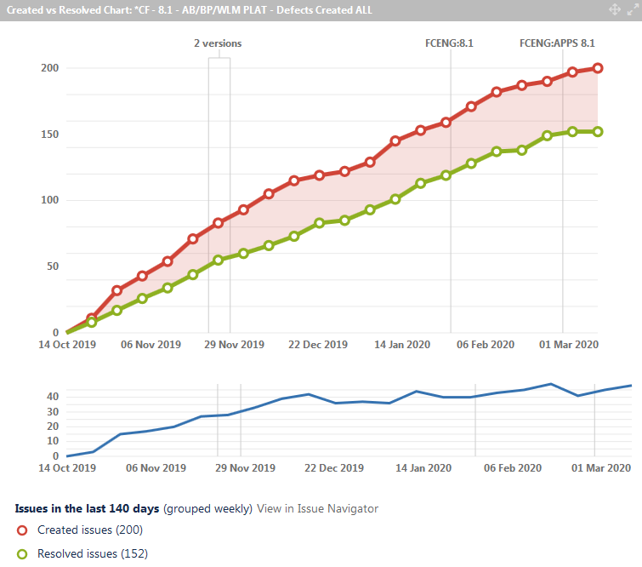
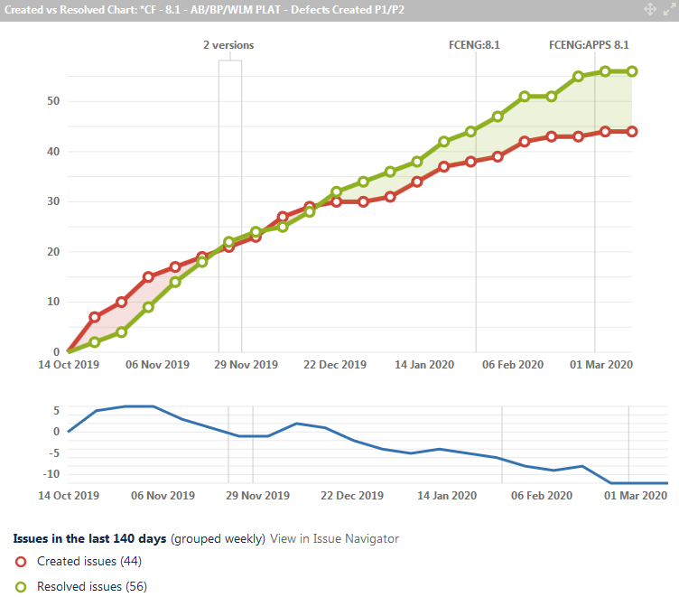
EIM Base Platform Monthly QA Metrics
JIRA Dashboard Metrics on Defect Generation for V8.1 – February 2020
Cumulative 8.1 Defects Created v Resolved
Cumulative 8.1 P1/P2 Defects Created v Resolved
The EIM Base Platform / Application Builder cumulative defect numbers are tracked in JIRA Dashboard widgets.
The historical trend of open defects at the end of each month has been broadened to show a period through v8.1 development to release in February 2020 and beyond. Significant defect resolution is underway in current Sprints.

Slide 45
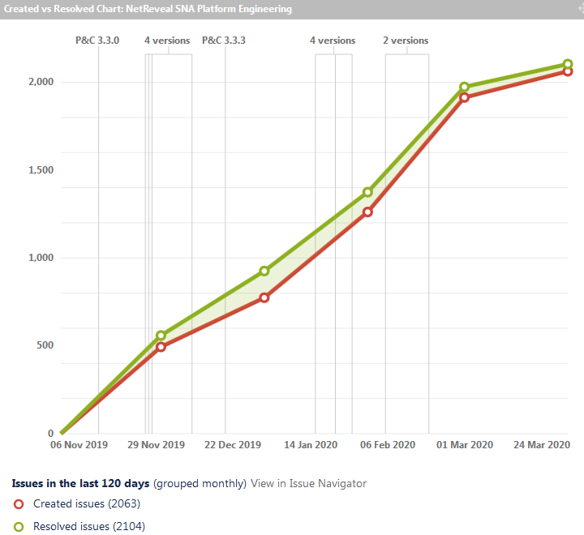
SNA Platform Bugs - Created v Resolved

Slide 46
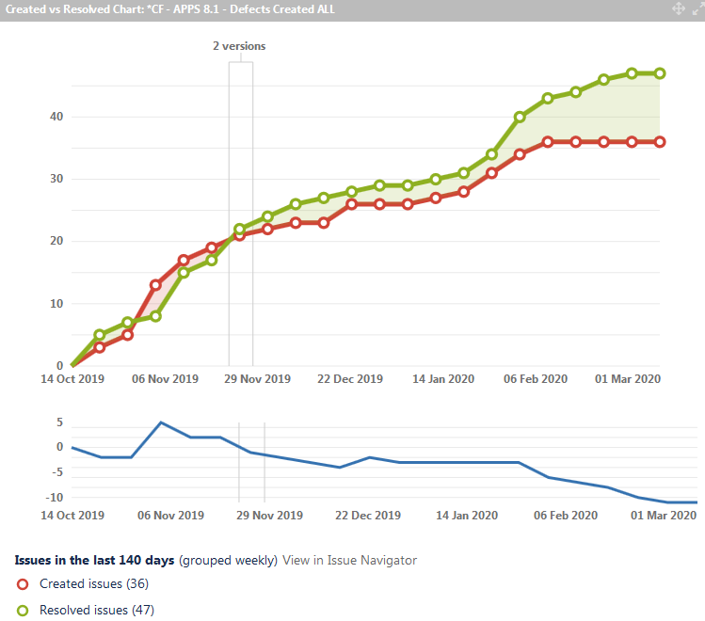
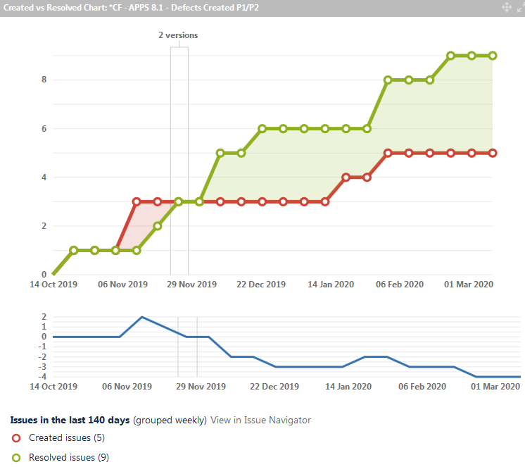
EIM APPS Monthly QA Metrics
JIRA Dashboard Metrics on Defect Generation for APPS 8.1 – February 2020
Cumulative APPS 8.1 Defects Created v Resolved
Cumulative APPS 8.1 P1/P2 Defects Created v Resolved
JIRA Dashboard widgets report on cumulative defect numbers for APPS 8.1 and beyond.
The ‘Open Defect’ count is collated from the four Scrums teams working on APPS 8.1 deliverables.

Slide 47


SMBD /ARTE Monthly QA Metrics
JIRA Dashboard Metrics on Defect Generation for SMBD / RTDE – February 2020
Cumulative SMBD and RTDE Defects Created v Resolved
Cumulative SMBD and RTDE P1/P2 Defects Created v Resolved
The above graphs collate defects created in Sprint activity for both current SMBD and RTDE release development. Majority of defects raised between August 2019 to February 2020 are category P4 or P5.
As with other teams, the open defect numbers will be tracked at the end of each Sprint cycle.

Slide 48


Advanced Analytics Platform QA Metrics
JIRA Dashboard Metrics on Defect Generation for AAP – February 2020
Cumulative AAP Defects Created v Resolved
Cumulative AAP P1/P2 Defects Created v Resolved
The timeframe for the above graphs reflects the lead in to the current AAP Sprint activity for v8.1.0.2 release and beyond. All major open defects were closed for the release, while new defects have started to be identified on the new feature development for next release.
Similar to other teams, AAP open defect numbers will be tracked at the end of each Sprint cycle.

Slide 49
Defect Metrics Summary – EIM Platform + APPS
60+ Day View of Defect Trends for EIM + APPS
EIM Production Defect Analysis – 2019 YTD
200+ GEP JIRA View of Defect Trends for EIM + APPS

Slide 50



Defect Tracking Metrics – February 2020
SNA Defect Tracking + Open Defects + Defect Resolution Trends
NR SNA Component – Volume of defects created in the last 200 days.
NR SNA – Average number of days issues remained unresolved.
NR SNA – Current open issue profile (created in the last 200 days) 15 P2 – P4 defects were raised in February 2020

Slide 51



Defect Tracking Metrics – February 2020
APPSDEV Defect Tracking – APPS 8.x development and post release timeframe
APPSDEV – Rate of defects created vs resolved – in the last 60 days.
APPSDEV – Rate of defects, raised by Scrum teams, in APPS 8.1 timeframe. (“4.x” JIRA query expanded to cover APPS 8.1).
APPSDEV – Breakdown of defects raised, by Engineering Scrum teams, in last 200 days by Component.

Slide 52




Defect Trend Metrics – APPS –2019/2020
Q1 2019-Q1 2020 Overview of APPS Defect Volumes (APPSDEV on GEP JIRA + WLM APPS)
The data reflects the general activity throughout APPS v8.1 delivery work. The numbers also include WLM APPS defects.

Slide 53


Defect Tracking Metrics – February 2020 (1)
EIM APPS – Post Release Issues (Product Configuration Layer)
EIM APPS – 22 tickets were raised on post release versions of APPS Solutions from 1st Jan 2020 to date.
EIM APPS – These tickets were raised on GA versions of APPS releases by Services, Customer Engineering and Customer Support.
2 P1 issues have been raised until end February 2020.
1 issue raised on PBB Upgrade related to Scenario Manager (Unable to open AML Scenario DUX). New – Advised to upgrade to release build: core 8.1.0.1
1 tomcat crash issue (SSL startup options) raised by Erste Group Upgrade NR8. Assigned – under investigation.
2 P2 issues raised.

Slide 54



Defect Tracking Metrics – February 2020
EIM Base Platform / Application Builder Defect Tracking
EIM BP/AB – Rate of defects created vs resolved – in the last 60 days.
EIM BP/AB – Rate of defects, raised by Scrum teams – Sep 2019 to date i.e. during 8.1 development to release.
EIM BP/AB – Breakdown of defects raised , by Engineering Scrum teams, in last 200 days by Component.

Slide 55




Defect Trend Metrics – EIM PLATFORM (+WLM)
Q1 2019–Q1 2020 - Overview of EIM PLATFORM (including WLM PLATFORM) Defect Volumes
These figures represent all ‘Defect’ issue types raised on the EIM Platform, and WLM Platform, project since March 2019 covering 8.0/8.0.1 and 8.1 release.

Slide 56


Defect Tracking Metrics – February 2020 (2)
EIM Base Platform / Application Builder / WLM / Classic SM – Post Release Issues
EIM BP/AB – 46 tickets were raised on post release versions of the EIM Platform from 1st Jan 2020 to date.
EIM BP/AB – These tickets were raised on GA versions of the EIM Platform by Services, Customer Engineering and Customer Support.
0 P1 issue has been raised until end February 2020.
17 P2 issues raised so far.

Slide 57
QA Automation Metrics/Trends + Coverage – EIM Platform + APPS
2019 and 2020 Increases in QA Test Automation Numbers
Metrics on % Coverage of Regression/New Feature Tests by Test Automation

Slide 58
QA Automation Trend Metrics – SNA Platform
Ongoing Increase in QA Automation (Current numbers of test automation)
We now have ~590 BDD tests, including e2e tests for the complete alert management workflow (triage, investigation, link to case, close as fraud/not fraud), scorecard manager and search.
Test numbers dipped in H1 2019 because older, redundant tests were being removed or consolidated as development moves onto new technology stacks. Test case numbers are rising significantly again, keeping pace with new P&C functionality.

Slide 59

QA Automation Metrics – February 2020
Table from EIM Test Automation Dashboard – includes test automation in 2019/2020
711 APPS (WLM, AML/FinCEN, Fraud) Selenuim automation test cases have been written to date from 2017 - 2020. At present the focus by product QA is on building the WLM APPS test suite (369 automated tests). Other APPS Scrum teams have started to build their Selenium test suites.
SM UI (Ducks) test automation have been updated since September 2019. At present 195 out of 222 test cases have been automated.

Slide 60
QA Automation Trend Metrics – EIM Platform
Ongoing Increase in QA Automation (Cumulative Metrics)
Regression/New Feature Test Suite
 |  | TC Numbers | Automated TCs | % Coverage
 | Total | 1132 | 369 | 32.6%
Although the current regression suite contains 1132 test cases, the focus is on automating test cases/scenarios of new features as part of the objective to increase test automation coverage significantly in 2020.
It is expected that from February 2020 the trend in new test automation will progress further in a noticeably upward trend.

Slide 61
QA Automation Trend Metrics – WLM Platform
Ongoing Increase in QA Automation (Cumulative Metrics)
Regression/New Feature Test Suite
 |  | TC Numbers | Automated TCs | % Coverage
 | Total | 777 | 715 | 92.0%
The WLM Platform QA focus is to continue automation of new features as part of the objective to increase/maintain test automation coverage.
The current automated test coverage is 92%.

Slide 62
QA Automation Trend Metrics – APPSDEV
Ongoing Increase in QA Automation (Cumulative Metrics)
Regression Test Suite
 |  | TC Numbers | Automated TCs | % Coverage
 | Total | 711 | 431 | 61.0%
Current 8.1 February 2020 metrics now exclude CasperJS numbers and are focused on Selenium automation tests contributed by APPS Scrum teams (WLM APPS, Archeo, Frogs). An additional reduction in the February numbers (225 test cases) is attributed to the removal of legacy (not used) Selenium / Frameworkium tests (AML/EIM Framework/FinCEN).
Total priority high-value test cases, which form the baseline for those we wish to automate, have been re-assessed from 1032 to 711. Our current test coverage thus stands at 61% and is projected to improve significantly in 2020.

Slide 63
QA Automation Trend Metrics – SMBD/RTDE
Ongoing Increase in QA Automation (Cumulative Metrics)
Regression Test Suite
 |  | TC Numbers | Automated TCs | % Coverage
 | Total | 1089 | 1079 | 99%
By the end of 2017 there were 148 automated test cases written in Scala Scripts/Gradle for SMBD by the QA relevant team members. At the end of February 2020, this total figure has increased to 1079 with 99% coverage.
These automation numbers now include the separate test automation work streams for both the SM Big Data and RTDE (Real time) modules.

Slide 64
QA Automation Trend Metrics – AAP
Ongoing Increase in QA Automation (Cumulative Metrics)
Automation Test Coverage - % of Manual Tests
 |  | TC Numbers | Automated TCs | % Coverage
 | Total | 156 | 81 | 52%
Ongoing test automation coverage is approximately 52% of the overall QA test suite for the AAP Product.
AAP QA focus had been shifted in H2 2019 to also address performance and integration work, but we expect that automation numbers will grow at a consistent pace throughout 2020. Trends in Q1 2020 are already positive in terms of test automation growth.

Slide 65
QA Automation Trend Metrics – Scenario Manager UI
Ongoing Increase in QA Automation (Cumulative Metrics)
Automation Test Coverage - % of Manual Tests
 |  | TC Numbers | Automated TCs | % Coverage
 | Total | 222 | 195 | 87.84%
Ongoing test automation coverage is at almost 88% of the overall QA test suite for the SM UI Product.

Slide 66
APPENDIX – 1 EIM / APPS - Release Metrics
Overview of QA facilitation of Release sign off process
Release metrics collated for the last six major EIM + APPS Product deliveries – including V8.1 in February 2020

Slide 67

NR V8.1 – GA February 2020
NetReveal 8.1 Key Release Metrics
NetReveal Compliance and Payment Fraud V8.1 release delivered on schedule and with the scope of content as agreed with Product Management and Senior Management.
Key QA release metrics;
1128 new test cases were written for new features in NetReveal 8.1 and defect verification. All tests were executed over Sprints cycles in the NetReveal 8.1 development lifecycles.
7949 regression tests were executed in the same NetReveal 8.1 timeframe by the Scrum teams.
There continues to be a trend of a significantly higher ratio of regression test executions when compared to new test case execution . Reasons for this pattern are;
The volume of test automation continues to grow and allows for greater volumes of regression test execution with each subsequent NR Product (EIM/APPS/SMBD/RTDE) release.
QA is consistently converting ‘new’ test cases from prior releases into a growing current regression test suite.
QA testing for V8.1 also focused on running multiple regression cycles on new technology stacks (Postgres, Tomcat, etc.).
0 EIM NetReveal 8.1 P1 or P2 severity issues remained open on the release date;

Slide 68

NR (EIM /APPS) – Release Metric Comparison
EIM/APPS QA Release Metrics for last six Product releases
The volume of QA test cases being executed per release is increasing in line with an ongoing growth in automated test regression.
Pass rates have been consistent over the last six NR (EIM/APPS) Product releases. The volumes of defects found is slightly higher in V8.1 but that may reflect the marginally longer development timeframe.

Slide 69

NR (EIM /APPS) – Automation Metric Comparison
EIM/APPS Increase in QA test automation over last six Product releases
Since mid 2017, technologies such as Java Selenium have steadily increased the volume of QA test automation.
The V8.0 QA process involved slightly more reliance on manual testing because of significant numbers of visual UX tests, but that trend did not continue into V8.1.

Slide 70

NR V8.0 (EIM 8.0/APPS 5.0)–GA March 2019
V8.0 Key Release Metrics – EIM and APPS Combined for this release
NetReveal Compliance and Payment Fraud V8.0 (EIM platform 8.0/APPS 5.0) release delivered on schedule and with the scope of content as agreed with Product Management and Senior Management.
Key QA release metrics;
392 new test cases were written for new features in EIM 8.0/APPS 5.0 and defect verification. All tests were executed over Sprints cycles in the EIM 8.0/APPS 5.0 development lifecycle.
3743 regression tests were executed in the same EIM 8.0/APPS 5.0 timeframe by the Scrum teams.
There is a noticeably lower ratio of new tests created/executed compared to regression test numbers in previous releases. Reasons for this change are;
The underlying EIM Platform changes did not require new functional tests. Existing regression was extended and executed multiple times of different technology platforms.
The volume of test automation continues to grow and allows for greater volumes of regression test execution with each subsequent NR Product (EIM) release.
WLMS APPS testing also focused on running significant regression on new technology stacks (Postgres, WAS Liberty).
Other solution layer testing, apart from Payment Fraud, spent significant effort on extending existing automated regression tests.
0 EIM 8.0/APPS 5.0 P1 or P2 severity issues remained open on the release date;
On release, 33 P3 issues were open on the EIM 8.0/APPS 5.0 release.

Slide 71

EIM 7.7 / APPS 4.9 – December 2018
Key Release Metrics – EIM and APPS Combined for this release
EIM Platform 7.7 / APPS 4.9 released on schedule and with the scope of content as agreed with Product Management and Senior Management
Key QA release metrics;
784 new test cases were written for new features in EIM 7.7/APPS 4.9 and defect verification. All tests were executed over Sprints cycles in the EIM 7.7/APPS 4.9 development lifecycle.
1778 regression tests were executed in the same EIM 7.7/APPS 4.9 timeframe by the Scrum teams. The higher regression numbers reflect the impact of ongoing cumulative automated regression tests.
3 EIM 7.7/APPS 4.9 P2 severity issues remained open on the release date;
1 – Application Builder already fixed and planned for inclusion in next ‘point’ release, which is likely to be EIM Platform version that ships with APPS 4.9.
1 – EIM Base Platform related to build process and not the release functionality.
1 – WLM Postgres issues being deferred to a later release.
On release, 29 P3 issues were open on the EIM 7.7/APPS 4.9 release.
SM Big Data test activity have also been included in the QA totals in the table below.
The selection of existing test cases in regression testing is based on defect trend analysis from previous APPS releases.

Slide 72

EIM 7.6 / APPS 4.8 – GA June 29th 2018
Key Release Metrics – EIM and APPS Combined for this release
RACI process concluded with all Stakeholder sign off on 28th June 2018 – EIM 7.6 and APPS 4.8 combined release.
EIM Platform 7.6 / APPS 4.8 released on schedule and with the scope of content as agreed with Product Management and Senior Management
Content details published on GEP Confluence, and incorporated into Training VMs made available at end of June 2018.
Key release metrics reviewed in formal RACI process;
1434 new test cases were written for new features in EIM 7.6/APPS 4.8 and defect verification. All tests were executed over Sprints cycles in the EIM 7.6/APPS 4.8 development lifecycle.
764 regression tests were executed in the same EIM 7.6/APPS 4.8 timeframe by the Scrum teams. The higher regression numbers reflect the impact of ongoing cumulative automated regression tests.
3 EIM 7.6 P2 severity issues remained open on the release date. 2 PostGresSQL on Base Platform and 1 WLM issue (non release critical).
On release, 25 P3 issues were open on the EIM 7.6/APPS 4.8 release.
SM Big Data test activity have also been included in the QA totals in the table below.
The selection of existing test cases in regression testing is based on defect trend analysis from previous APPS releases.

Slide 73

APPS 4.7 – GA December 21st 2017
Key Release Metrics
RACI process concluded with all Stakeholder sign off on 21st December 2017 – included underlying EIM 7.5 Platform release.
APPS 4.7 released on schedule and with the scope of content as agreed with Product Management and Senior Management
Content details published on GEP Confluence, and incorporated into Training VMs made available at end of December 2017.
Key release metrics reviewed in formal RACI process;
687 new test cases were written for new features in APPS 4.7 and defect verification. All tests were executed over Sprints cycles in the APP 4.7 development lifecycle.
313 regression tests were executed in the same APPS 4.7 timeframe by the Scrum teams. Thus, 1000 test cases were run in total for APPS 4.7.
Zero APPS 4.7 high severity issues remained open (P1 or P2) on the release date.
On release, 38 P3 issues were open on the APPS 4.7 release (relating specifically to 4.7).
A growing volume of regression is being continually automated in Selenium and added to the priority regression test suite. For simplicity, the automated and manual regression test numbers have been combined in the tables below.
The selection of existing test cases in regression testing is based on defect trend analysis from previous APPS releases.

Slide 74

EIM Platform 7.5 – GA December 1st 2017
Key Release Metrics
EIM Platform 7.5 released on schedule on December 1st 2017, with the scope of content as agreed with Product Management and Senior Management
The formal RACI process for EIM 7.5 was included in the APPS 4.7 release and concluded with full APPS Stakeholder sign off on 21st December 2017.
Content details were published on GEP Confluence, and incorporated into APPS 4.7 Training VMs, which were made available at the end of December 2017.
Key release metrics reviewed in formal RACI process;
241 test cases were written for new features in V7.5 and defect verification. All were executed over Sprint cycles in the EIM 7.5 lifecycle.
159 regression test cases were executed in the same V7.5 development timeframe.
Zero V7.5 EIM high severity issues remained open (P1 or P2) on the release date.
On release, 31 P3 issues were open on the EIM 7.5 platform (relating specifically to 7.5).
Post release performance benchmarking scheduled for Q1 2018 (since executed).
EIM 7.5 test case metrics:

Slide 75

APPS 4.6 – GA September 31st 2017
Key Release Metrics
RACI process concluded with complete Stakeholder sign off on September 31st 2017 – included underlying EIM 7.4 Platform release.
APPS 4.6 released on schedule and with the scope of content as agreed with Product Management and Senior Management.
Content details published on GEP Confluence, and incorporated into Training VMs made available at end of September 2017.
Key release metrics reviewed in formal RACI process;
1143 new test cases were written for; new features in APPS 4.6, application regression, and defect verification. All tests were executed over Sprints cycles in the APP 4.6 lifecycle.
One APPS 4.6 high severity issues remained open (P1 or P2) on the release date. This was in relation to Parameter Optimisation functionality, and it was agreed in the RACI process to address this requirement in an immediate 4.6.1 release timeframe.
On release, 39 P3 issues were open on the APPS 4.6 release (relating specifically to 4.6).
Automated regression testing in Selenium commenced within the APPS 4.6 release and, although relatively low, have been included in the number below.
The selection of existing test cases in regression testing was based on defect trend analysis from previous APPS releases.

Slide 76

EIM Platform 7.4 – GA June 30th 2017
Key Release Metrics used in the RACI process
EIM Platform 7.4 released on schedule on June 30th 2017, with the scope of content as agreed with Product Management and Senior Management
Formal RACI process for EIM 7.4 was included in the APPS 4.6 release and concluded with full APPS Stakeholder sign off on 31st September 2017.
Content details published on GEP Confluence, and incorporated into APPS 4.6 Training VMs, which were made available at the end of September 2017.
Key release metrics reviewed in formal RACI process;
177 test cases were written for new features and defect verification in V7.4. All were executed over Sprint cycles in the EIM 7.4 lifecycle.
91 automated WLM regression tests were also run in the V7.4 timeframe.
Significant exploratory (ad-hoc) testing practices were introduced into the Sprint cycle – which raised a number of minor defect issues unrelated to the formal (written) test cases.
Zero V7.4 EIM high severity issues remained open (P1 or P2) on the release date.
On release, 33 P3 issues were open on the EIM 7.4 platform (relating specifically to 7.4).
EIM 7.4 test case metrics:

